Slide 1
Project Game & Watch
Designed by Team G.I. Joe, Phillip Conte, Yan Simon-Martel, Theo and Kosta

Slide 2

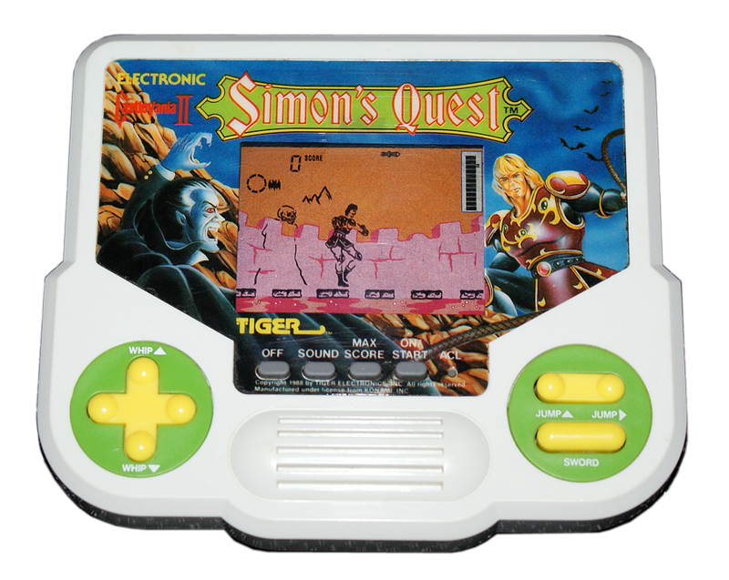
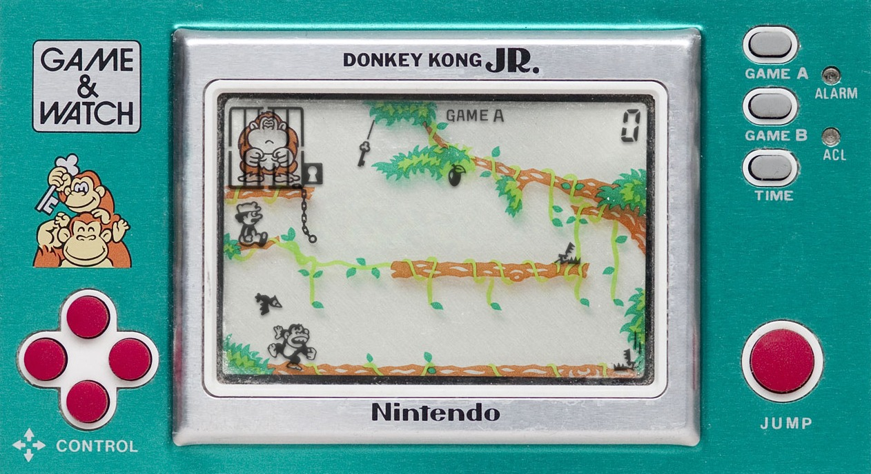
Premise
Project Game & Watch is a puzzle platformer in which you have to guide the main character to the end goal of each puzzle level by interacting with the different objects in the environment.

Slide 3

Theme
Project Game & Watch harks back to the first popular handheld devices of the 80’s: Game&Watch and Tiger Electronics handhelds.
Using the same type of visuals with detailed and static images as backgrounds and combining this with the LCD images in foreground for the character, platforms and other iteractable objects, Project Game & Watch aims to recreate that aesthetic.
Audio design also shares the same type of aesthetic but with an updated version of the sound effects and new chiptune music adapted for each level.

Slide 4
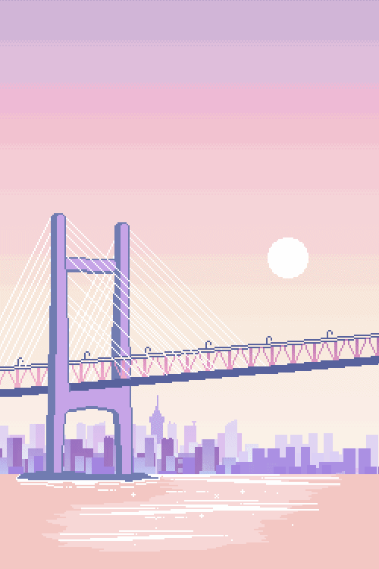
Game Experience
Players will be required to interact with the platforms, spikes and other foreground objects to find solutions to the puzzles presented in each level. Getting the highest score is the main source of excitement and goal of each level, but players must pay attention to the amount of tries on each level as this lowers the score multiplier. Timed based puzzles and interactions as well as limited controls also add to the stress. All this should proved players with the following experience:
Excitement of puzzle solving
Excitement of obtaining high scores
Stress of maintaining score multiplier
Stress of limited controls

Slide 5

Gameplay Mechanics
The player interacts with the different puzzles pieces:
Example: Moving platforms, bouncers, spikes,, gates, enemies, fans, falling objects
Player’s must time the activations to perform specific timed puzzles.
Player’s use the different interactable objects to find the solution to each puzzle/level.
Character is AI controlled and moves towards the goal.
Will automatically fall off ledges.
Dies from hitting spikes, enemies, crushed by pillars or gates.
Jumps when falling on bouncers
Floats over vertical fans, move faster or is blocked with horizontal fans.

Slide 6

Gameplay Mechanics (cont.)
Controls are minimalist:
Left & right: change selected object
Enter: interact with object
Object list:
Static platform: Doesn’t move.
Movable platform:
Horizontal: Moves horizontally.
Vertical: Moves vertically.
Fixed: Once moved does not automatically move back. Needs to be interacted with again.
Timed: Moves back into position after a set time.
Eternal: Can be used an infinite number of times.
Usage: Can be used only a certain number of times.
Disappearing: Disappears periodically.

Slide 7

Gameplay Mechanics (cont.)
Bouncers: Bounces the character up at different arcs, needs to be pre-activated.
Spikes: Kills character on touching.
Eternal: Remain open.
Closable: Can be closed when interacted.
Timed: Reopens after a timed period.
Fixed: Remains closed .

Slide 8

Gameplay Mechanics (cont.)
Gates: Blocks path until opened.
Eternal: Remain open.
Closable: Can be closed when interacted.
Timed: Reopens after a timed period.
Fixed: Remains closed .
Fans: Push in the direction they face.
Vertical: Push up or down.
Horizontal: In the back makes the character go faster, in front prevents movement.
Falling objects: Timed falling objects that kill the character. Example coconuts.
Switches: Not interactable by player, only character. Triggers other objects.
End goal: Not interactable by player, only character. Triggers the end of the puzzle.

Slide 9
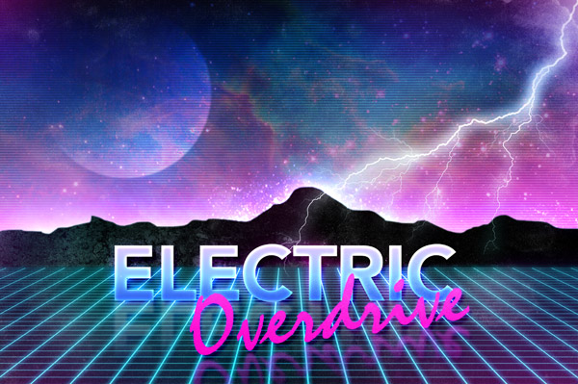


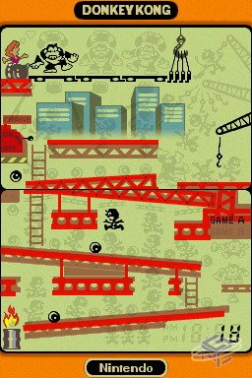
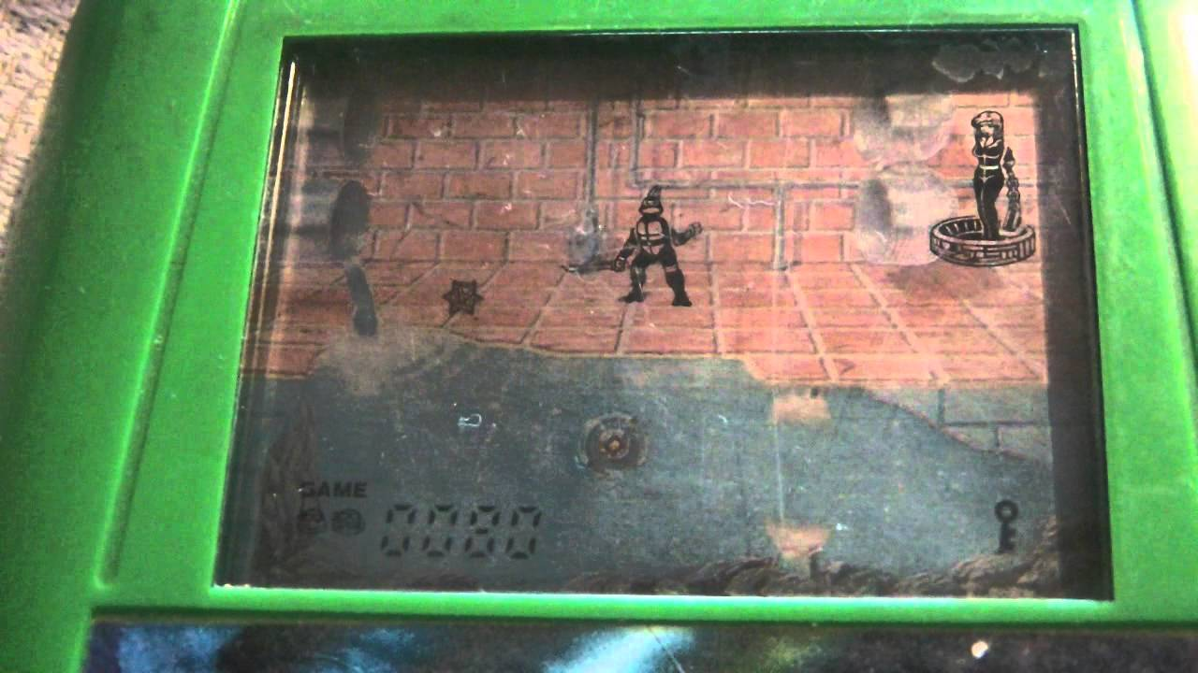
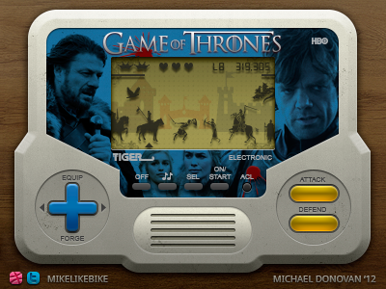
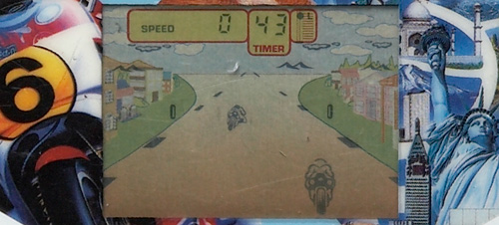
Moodboad / Inspiration

Slide 10
